Slide 1
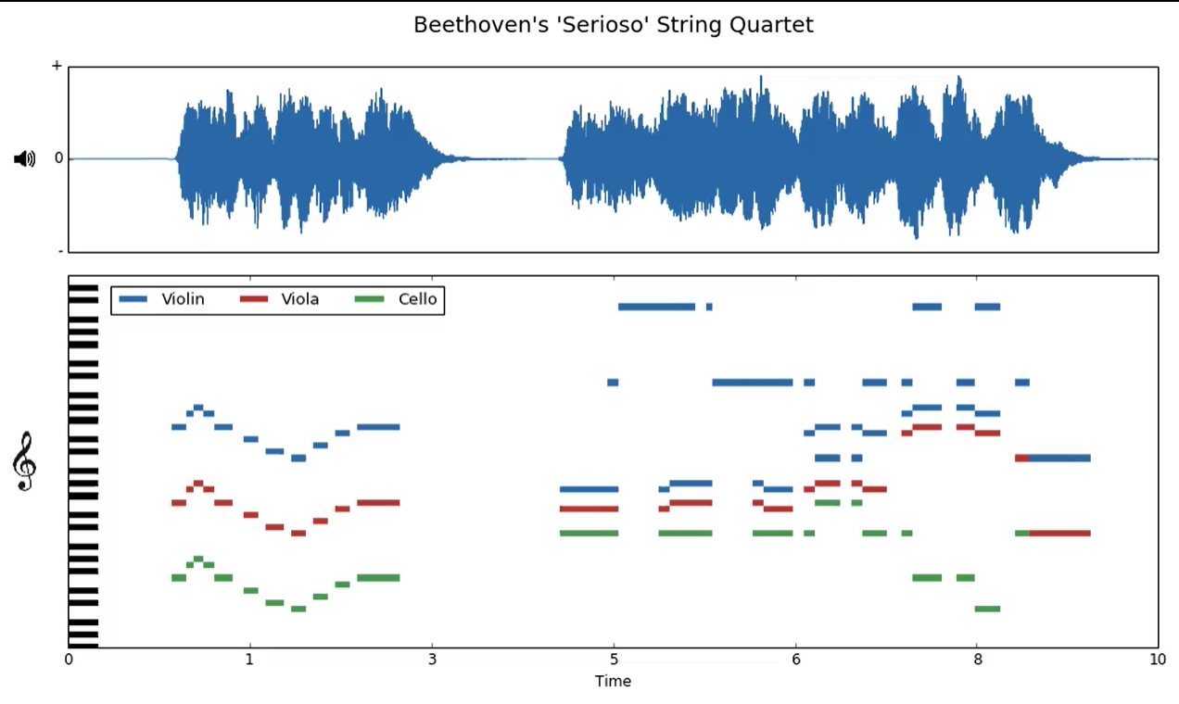
Quick recap
dataset of different kinds of music pieces from 10 different composers
Classify the music based on a X second window
spectrograms to do image classification

Slide 2
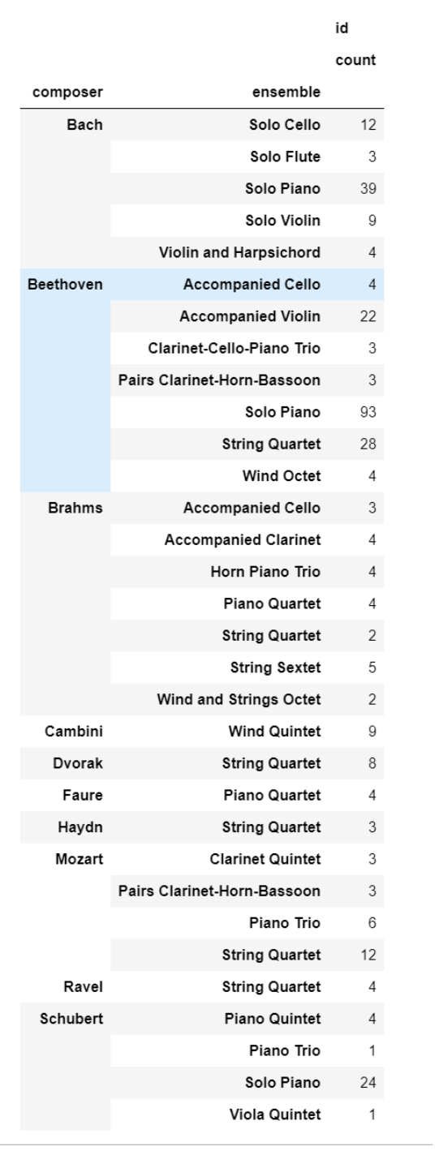
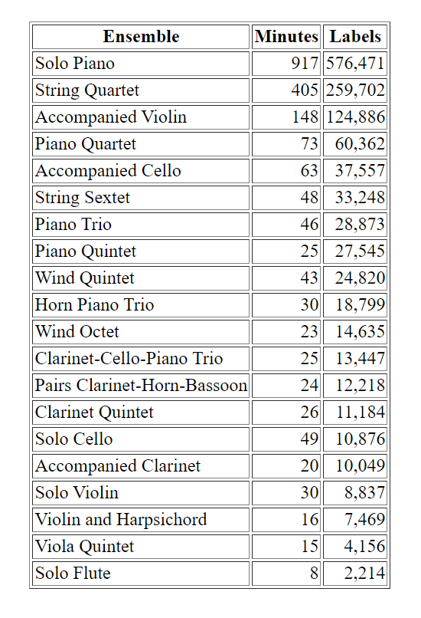
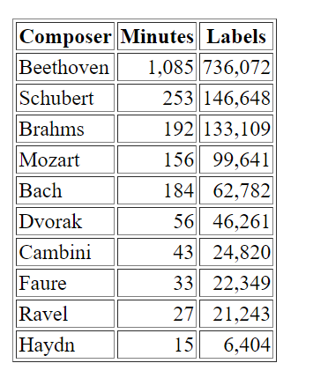
some analysis on the data

Slide 3
From own knowledge
Bach has a very specific style so should score well
Mozart and Haydn are notoriously hard to differentiate
It was custom to ‘steal’ parts of someone else's melody or theme, because you liked it and showed respect in that manner.

Slide 4
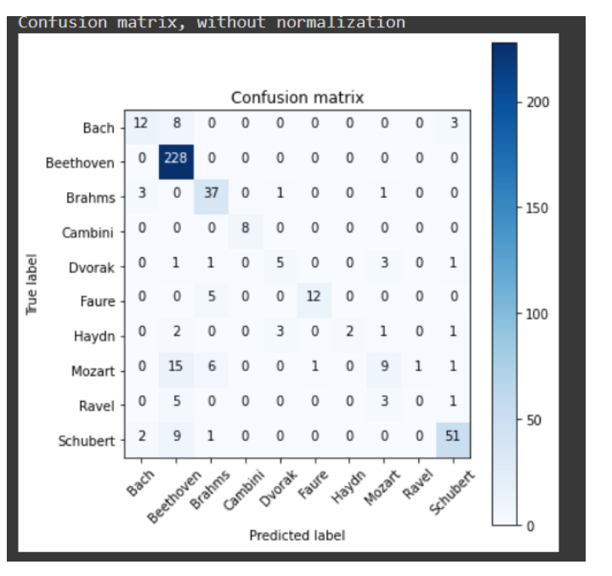
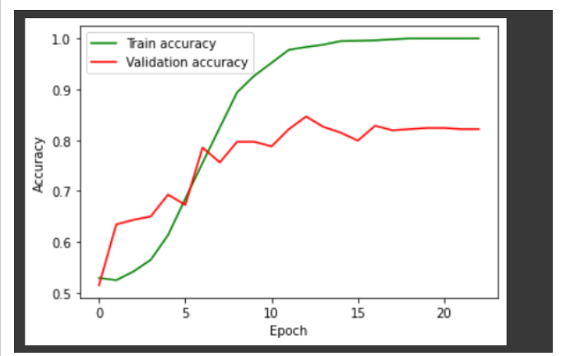
Cnn
Based on the analysis and on the fact that resnet did better decided to go deeper
best score 87%
does some haydn correct on val set!

Slide 5
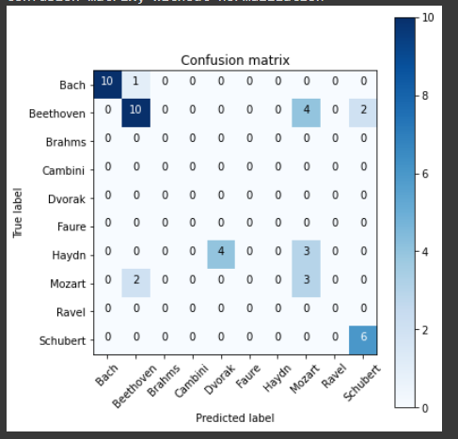
got 5 songs wrong based on voting on each piece ->86% acc
testset 64% acc
Bach 1685-1750
Haydn 1732-1809
Cambini 1746-1825
Mozart 1756-1791
Beethoven 1770-1827
Shubert 1797-1828
Bhrams 1833-1897
Dvorak 1841-1904
Faure 1845-1924
Ravel 1875-1937

Slide 6
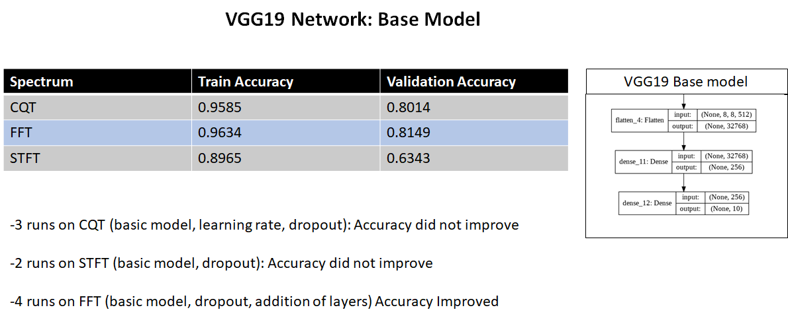

Slide 7
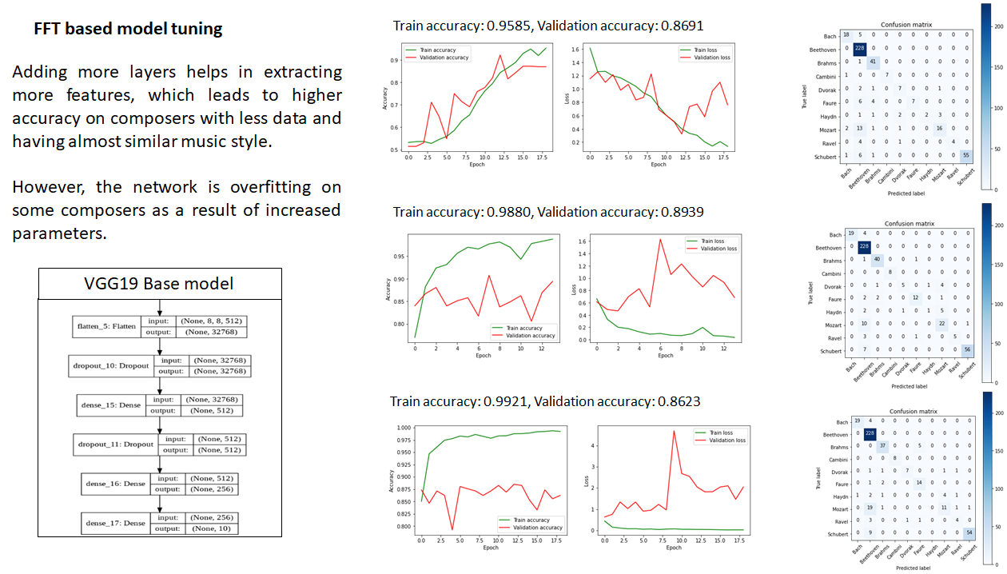

Slide 8
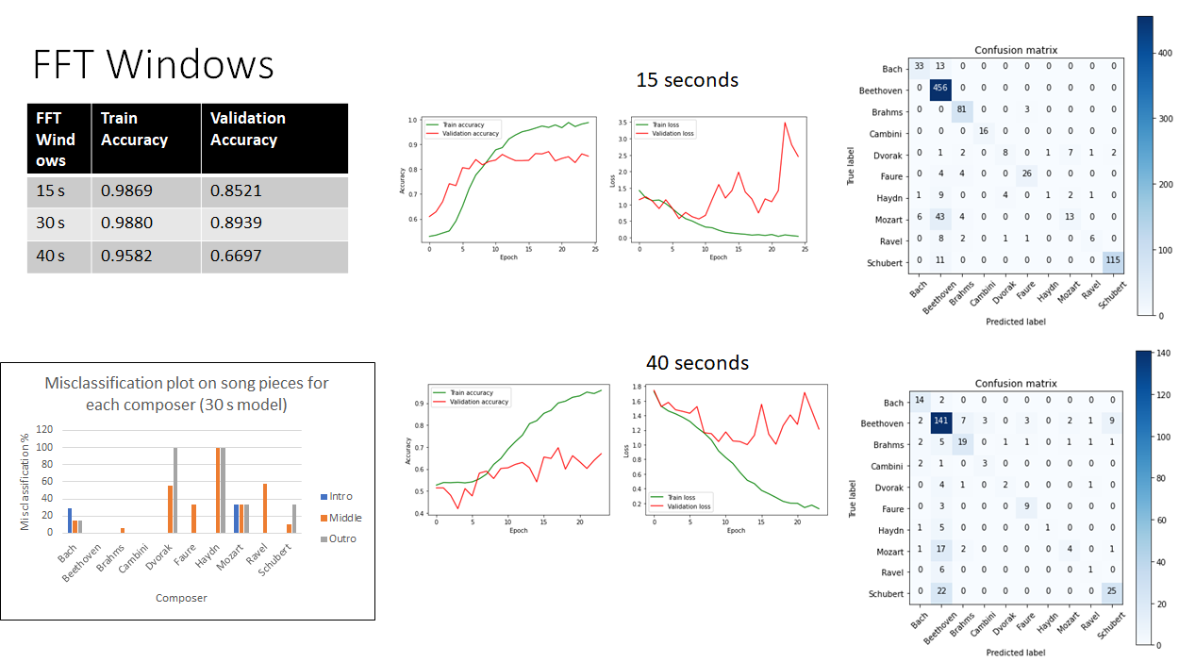

Slide 9
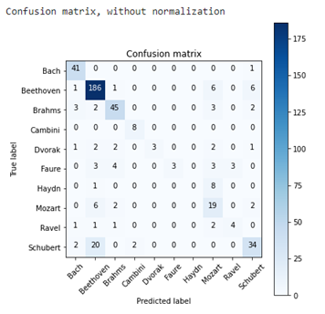
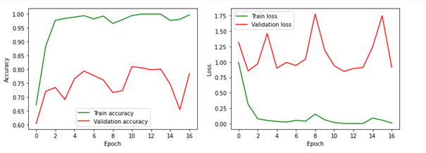
ResNet50 -> recap
Around 81% val_acc

Slide 10
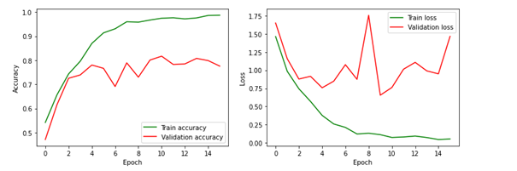
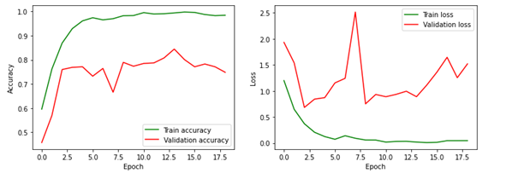
Dropout with maxnorm before 512-256-128 layers after ResNet: 81.69% val_acc
----------------------------
Reduced dropout (0.5-0.3 to 0.3-0.1):
84.44% val_acc

Slide 11
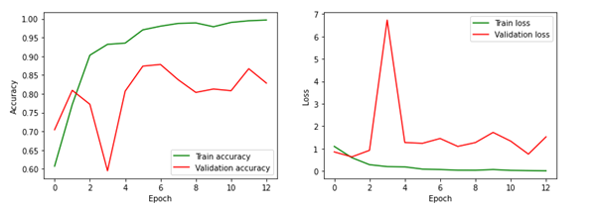
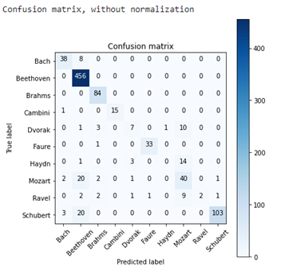
Final Model on 15s windows: 87.81 val_accuracy

Slide 12
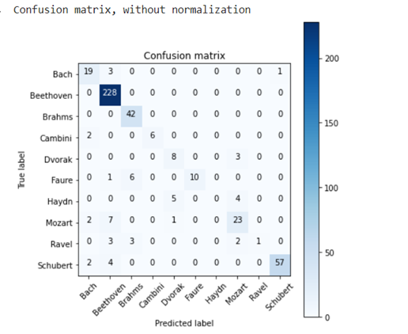
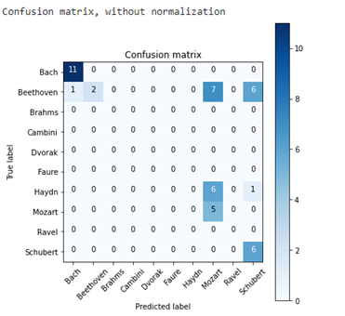
Final 30s windows model (88,94% val_accuracy)

Slide 13

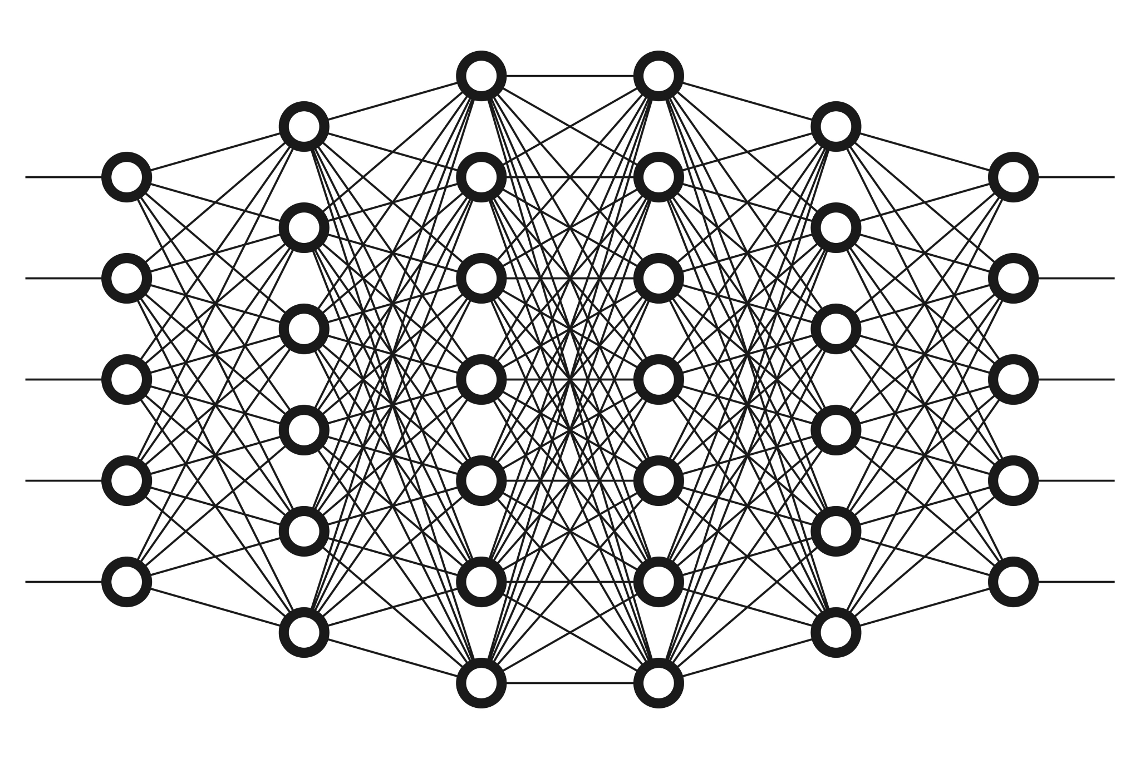
Final ResNet50 conclusions
-Good results on both 30s and 15s windows
-Full song prediction accuracy of 91.89% (3 songs wrong)
-Accuracy might even increase with ResNet101 or ResNet152

Slide 14
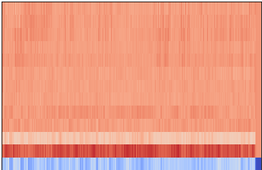
MFCC

Slide 15
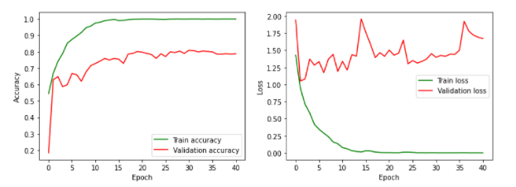
Inception V3
Dense | Validation accuracy
1 layer 1024 | 69%
2 layers 700/300 | 69%
2 layers 512/256 | 75%
2 layers 512/256 +dropout 0.1/0.2 | 78%

Slide 16
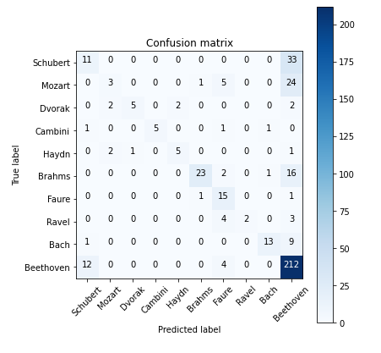
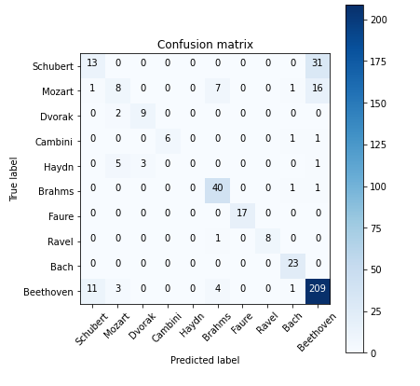
Final model
dense 700/300
First possible improvement: Augment the number of MFCCs

Slide 17
Things to explore in the future
voting classifier of multiple models
specific in-depth analysis of troublesome composers (Haydn)
get a dataset with the same kinds of music(all piano concerto for example)
try these models on music from today

